Slide 1




Assignment 3 Presentation
Sports Card Database
William B Weber
June 5th, 2018

Slide 2
Sports Card Database - Purpose
The Sports Card Database will store data about the cards in my collections.
The database will store card value, condition, player info, and sport being played.
I can use this info to quantify my collection to make decisions about which cards to keep or to sell.

Slide 3
Sports Card Database – Information Questions
What is the most valuable card?
What sport has the highest card average?
How many cards do I have for each sport?
What condition are my cards in?
How much is my collection worth?
Do I have players that play multiple sports?

Slide 4
Sports Card Database – Data Driven Decisions
What are the highest value cards to sell?
What is the total value of my collection?
What is the average price of each position?

Slide 5
Sports Card Database – Data Process
With the data provided I can better protect my more valuable cards.
I will be able to organize my duplicates for sale and know how much to sell them for.

Slide 6
Sports Card Database - Subjects
Player
Card

Slide 7
Sports Card Database - Characteristics
Player
Name (First, Last, Middle, Suffix)
Birthday
Where they are from (Hometown, State, Country)
Card
Player
Brand
Sport
Year
Value
Position
Quantity
Condition

Slide 8
Sports Card Database – Sample Data Values
Sport – Baseball, Football, Basketball
Condition – Mint, Very Good, Good, Poor, Very Poor
Brand – Topps, Upper Deck, Fleer, Score, Donruss, Hoops
Positions – LF, CF, RF, PG, SF, WR, QB, ILB, DBC

Slide 9
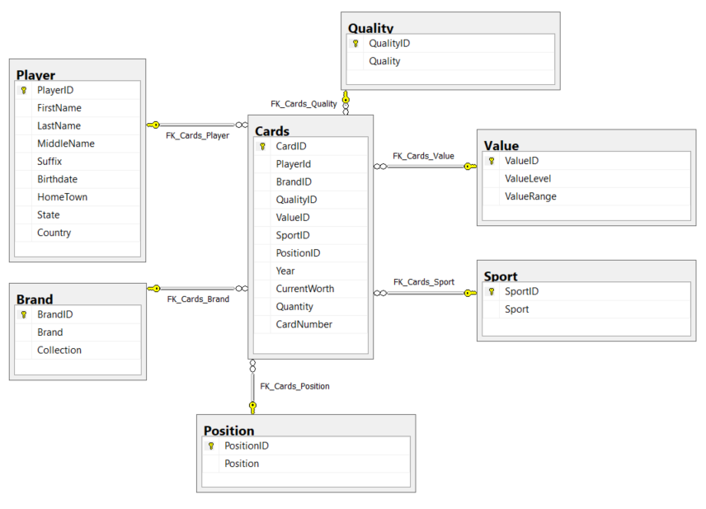
Sports Card Database - Diagram

Slide 10
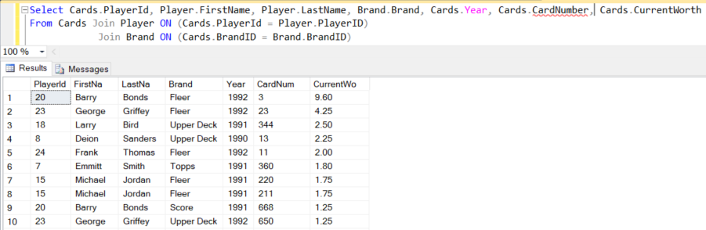
Sports Card Database – Example Query
What is my most valuable card?

Slide 11
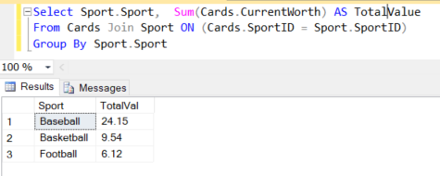
Sports Card Database – Example Query
What is the total card value by each sport?

Slide 12
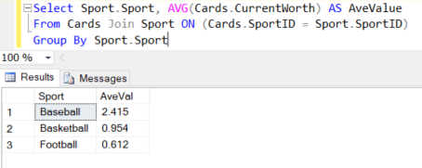
Sports Card Database – Example Query
What is the average card value for each sport?

Slide 13
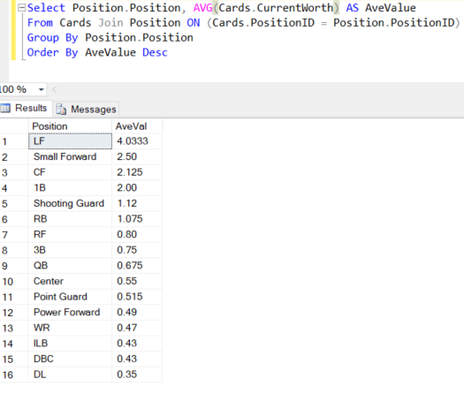
Sports Card Database – Example Query
What is the average card value for each position?

